Slide 1
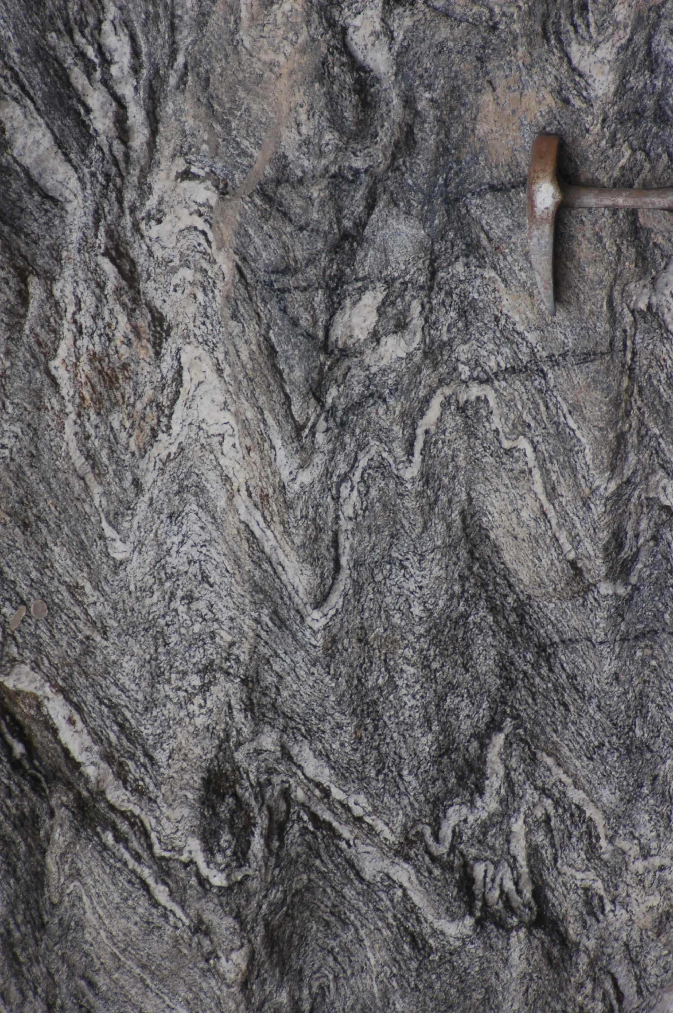
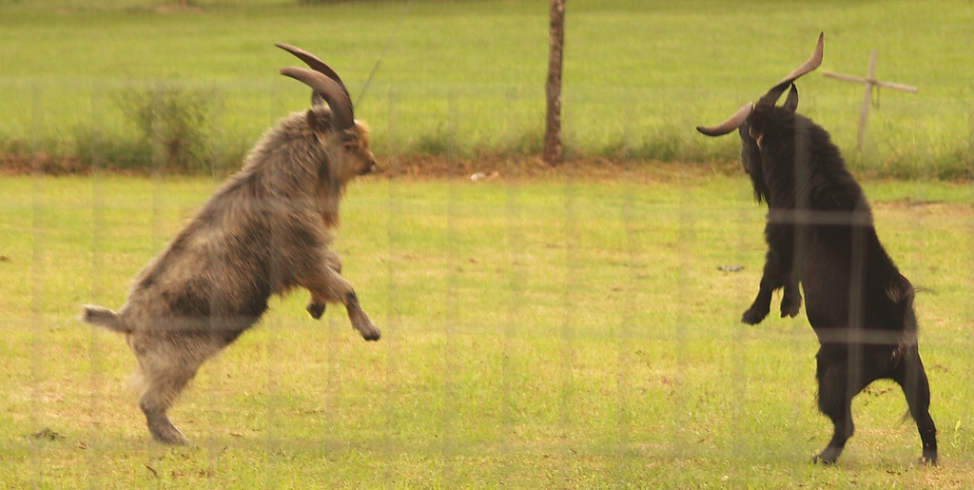
Collision Overview
Notes:
At this point in the course we are nearing the completion of the Wilson Cycle. Long-time rifted continents will smash together in spectacular slow-motion collisions that affect more rock than any other plate tectonic event. This lesson will give you an overview of the most important changes produced by these collisions and introduce you to their physiographic counterpoints …

Slide 2
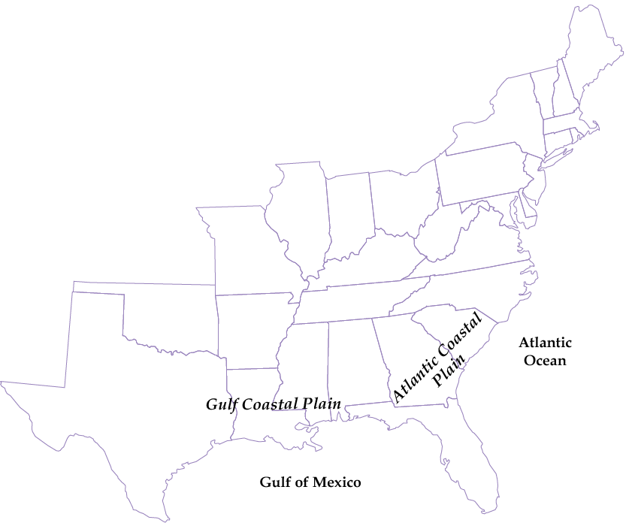
ANCIENT COLLISIONAL MOUNTAIN RANGE
Parks and Plates
©2005 Robert J. Lillie
Notes:
…along the Atlantic and Gulf coasts of the United States.

Slide 3
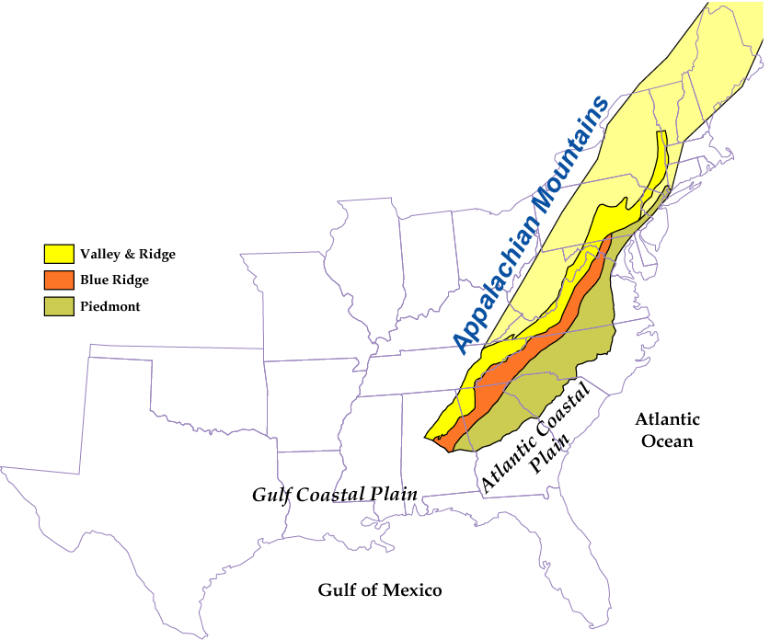
ANCIENT COLLISIONAL MOUNTAIN RANGE
Parks and Plates
©2005 Robert J. Lillie
Notes:
The Appalachian Mountains will figure prominently in our discussion, …

Slide 4
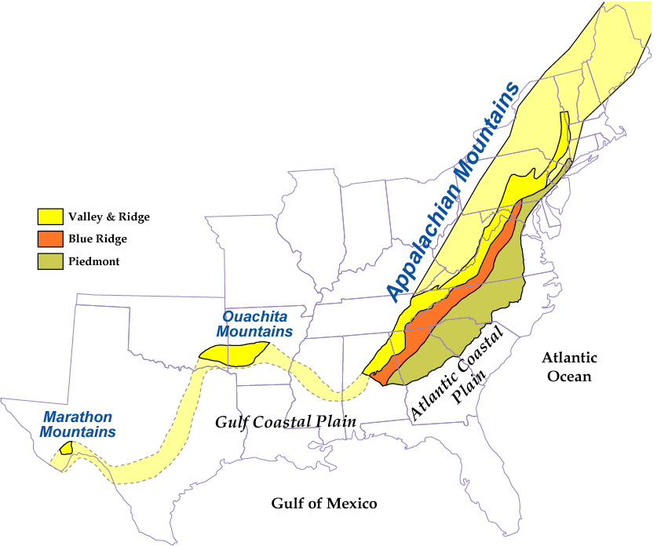
ANCIENT COLLISIONAL MOUNTAIN RANGE
Parks and Plates
©2005 Robert J. Lillie
Notes:
… but the structurally and temporally connected Ouachita and Marathon Mountains will also contribute to our understanding. Although once connected, the three old mountain ranges are now disconnected …

Slide 5
ANCIENT COLLISIONAL MOUNTAIN RANGE
Mississippi River
Foreland Basin
Parks and Plates
©2005 Robert J. Lillie
Notes:
… by the cover of younger foreland basin sediments in Texas and still younger sediments along the Mississippi River Valley.

Slide 6
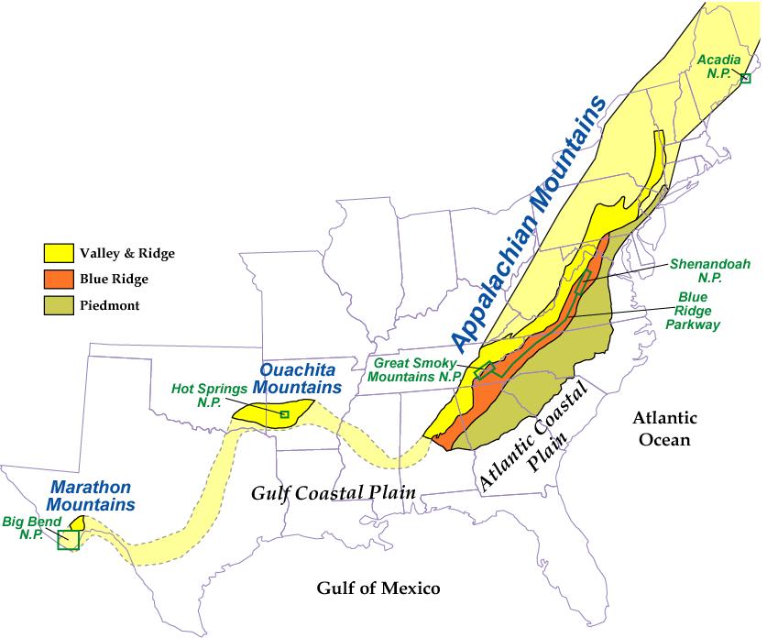
ANCIENT COLLISIONAL MOUNTAIN RANGE
Parks and Plates
©2005 Robert J. Lillie
Notes:
Ultimately we will cover five national parks along this great mountain system: Acadia, Shenandoah, Great Smokey, Hot Springs and Big Bend, but for now let’s have a look at the overarching principles.

Slide 7
Soft vs. Hard Collisions
Parks and Plates
©2005 Robert J. Lillie
Notes:
First up, collision intensity can vary. In a relatively “soft” collision between continents, …

Slide 8
Soft vs. Hard Collisions
DCM Sediments
Parks and Plates
©2005 Robert J. Lillie
Notes:
… only the DCM sediments on one side …

Slide 9
Soft vs. Hard Collisions
Accretionary Wedge
Parks and Plates
©2005 Robert J. Lillie
Notes:
… and the accretionary wedge material on the other …

Slide 10
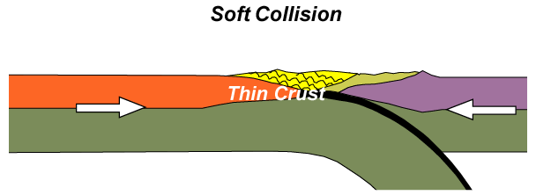
Soft vs. Hard Collisions
Parks and Plates
©2005 Robert J. Lillie
Notes:
… will be affected at the suture.

Slide 11
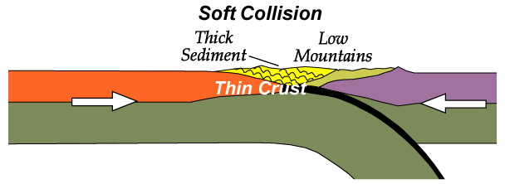
Soft vs. Hard Collisions
Parks and Plates
©2005 Robert J. Lillie
Notes:
The thick accumulations of sediment become folded and thrust-faulted into mountains, but of relatively low relief.

Slide 12
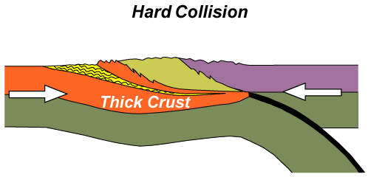
Soft vs. Hard Collisions
Parks and Plates
©2005 Robert J. Lillie
Notes:
More intense, “hard” collisions will also affect the continental basement atop which the DCM sediments are deposited.

Slide 13
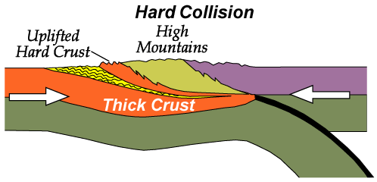
Soft vs. Hard Collisions
Parks and Plates
©2005 Robert J. Lillie
Notes:
The old, “hard” igneous and metamorphic rock basement is thrust over DCM sediments along with accretionary wedge material to form much higher mountains.

Slide 14
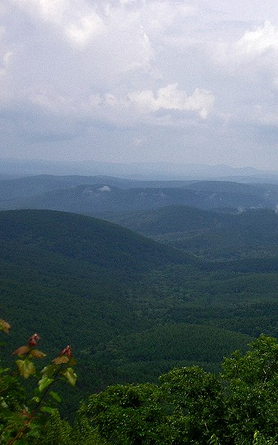
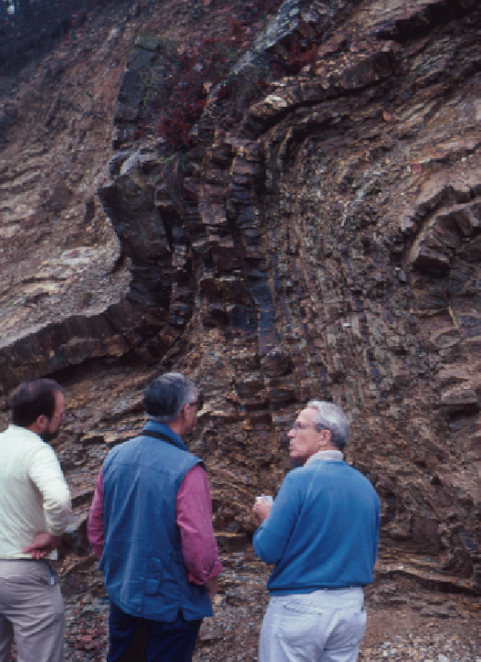
Soft Collision
Ouachita Mountains,
Arkansas
Parks and Plates
©2005 Robert J. Lillie
Notes:
The Ouachita Mountains in Arkansas, with their low relief and folded sedimentary rocks are good examples of “soft” collision mountains …

Slide 15
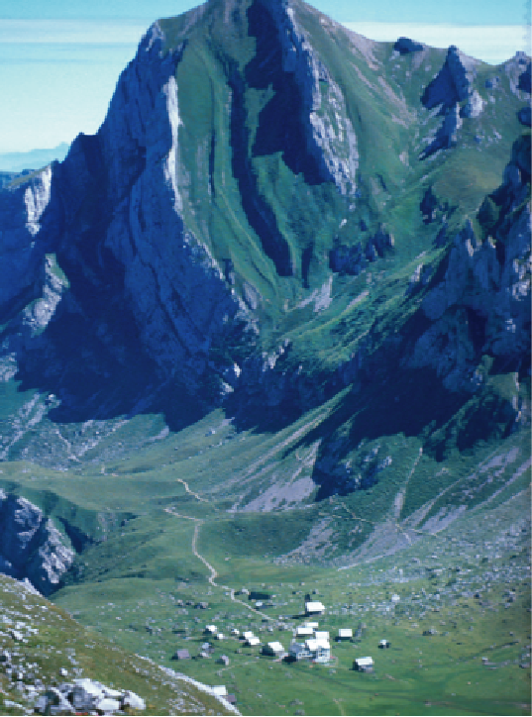
Hard Collision
Alps,
Switzerland
Robert J. Lillie
Parks and Plates
©2005 Robert J. Lillie
Notes:
… while “hard” collisions are exemplified by mountains like the towering Swiss Alps where the scale of folding and thrust faulting is much greater and often involves formerly deep-seated igneous and metamorphic rocks as well as their sedimentary covers.

Slide 16
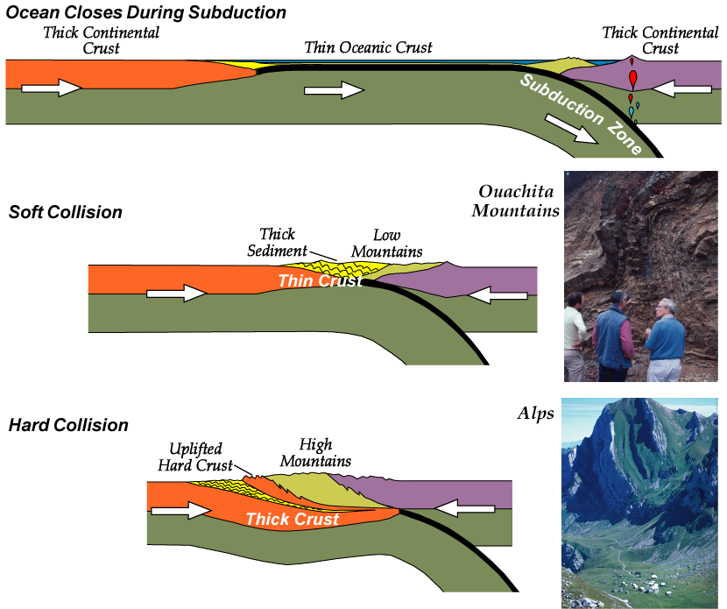
Robert J. Lillie
Robert J. Lillie
Parks and Plates
©2005 Robert J. Lillie
Notes:
In both types of collisions, but to a greater degree in hard collisions …

Slide 17
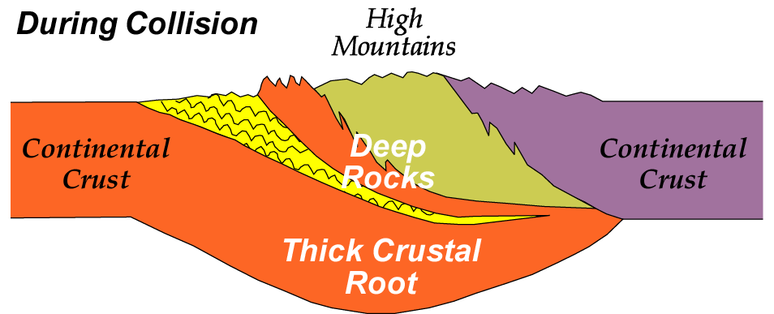
Parks and Plates
©2005 Robert J. Lillie
Notes:
Rocks that were buried deeply during collision …

Slide 18
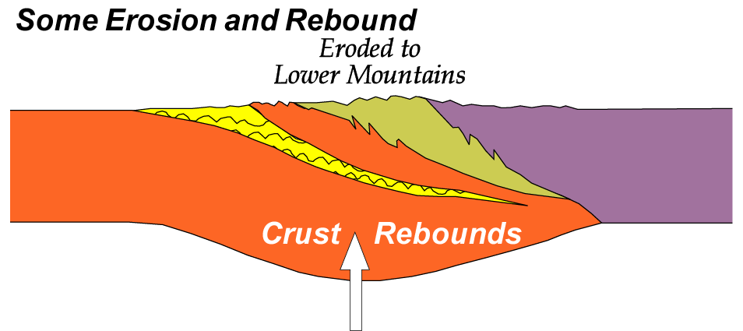
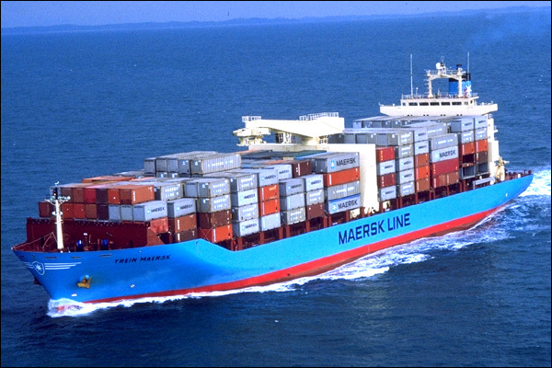
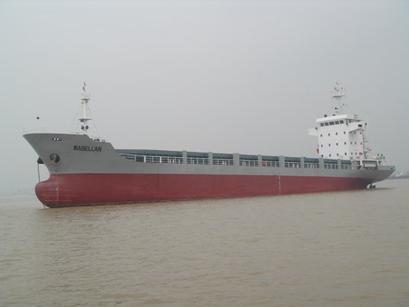
Parks and Plates
©2005 Robert J. Lillie
Notes:
… are later exposed during erosion and isostatic rebound, which is like a boat exposing its hull when it is unloaded.

Slide 19
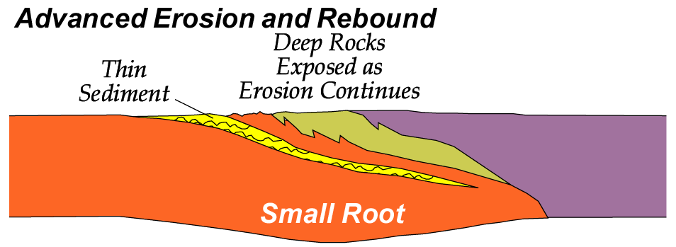
Parks and Plates
©2005 Robert J. Lillie
Notes:
Thus not only will “hard” crust be exposed in “hard” collisions, but eventually erosion and isostatic rebound will expose rocks that where carried to much greater depths and therefore subjected to higher grades of metamorphism.

Slide 20
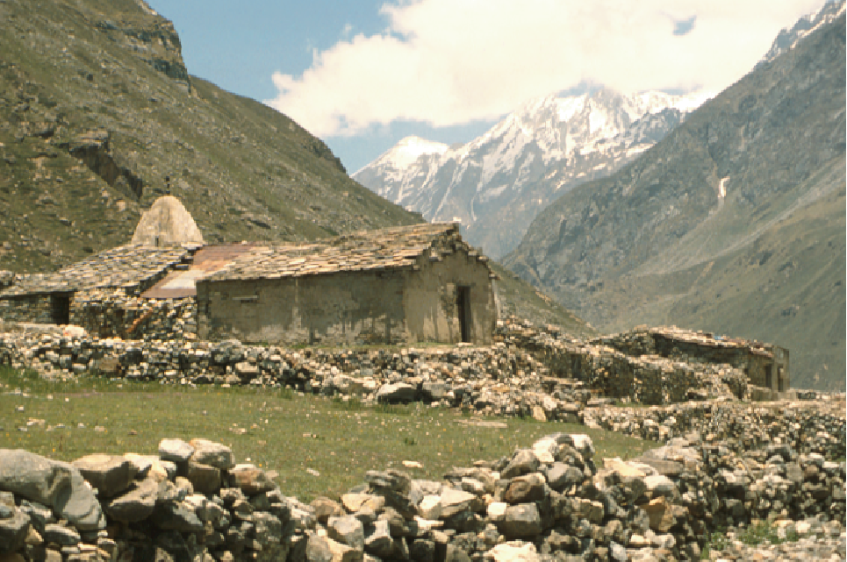
Very High Mountains During Collision
Himalayas, India/Tibet
Parks and Plates
©2005 Robert J. Lillie
Notes:
Today the Himalayas represent the very high mountains formed during the initial collision, …

Slide 21
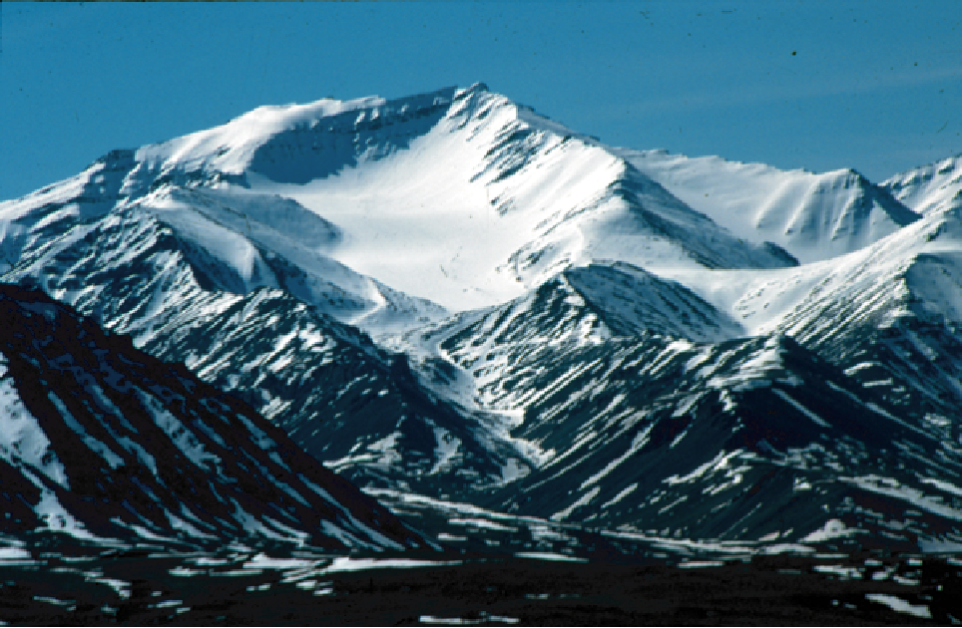
Moderate Height after some Erosion and Rebound
Gates of the Arctic National Park and Preserve, Alaska
Brooks Range
Parks and Plates
©2005 Robert J. Lillie
Notes:
… the Brooks Range in northern Alaska represents a range of moderate height after some erosion and rebound …

Slide 22
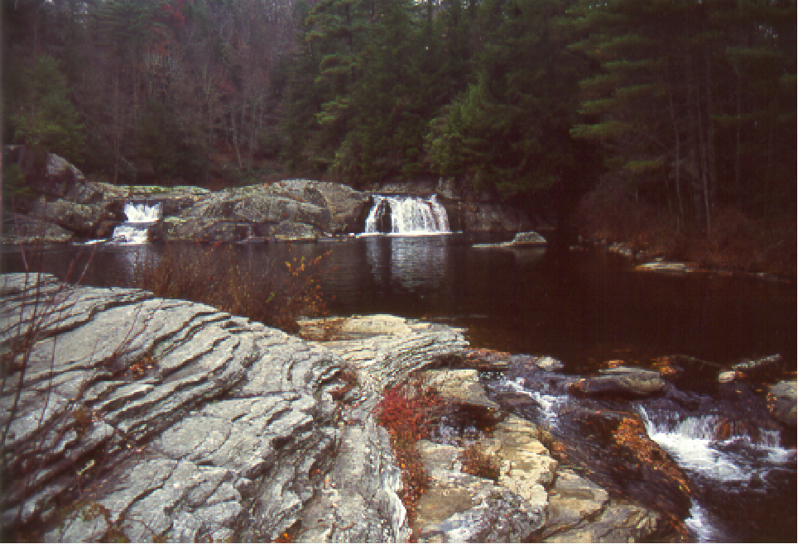
Lower Mountains after Extensive Erosion
Blue Ridge Parkway, North Carolina
High-Grade Metamorphic Rocks
Appalachian Mountains
Parks and Plates
©2005 Robert J. Lillie
Notes:
… and the Appalachians represent a much lower mountain range after extensive erosion has occurred. Correspondingly great amounts of isostatic rebound in the Appalachians have now exposed the once deeply buried high-grade metamorphic rocks at the surface.

Slide 23
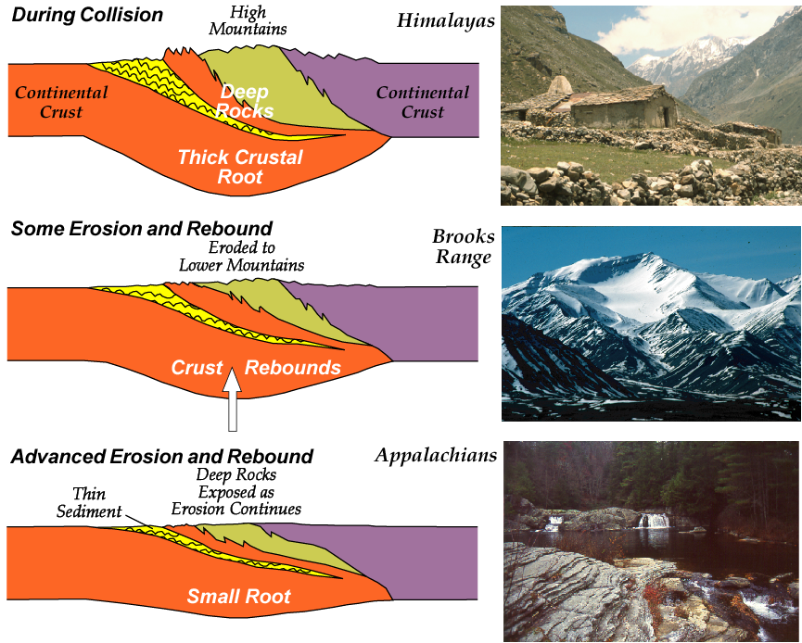
Robert J. Lillie
Robert J. Lillie
Robert J. Lillie
Parks and Plates
©2005 Robert J. Lillie
Notes:
In order to understand the formation of the Appalachians it will be helpful to bear that great depth of exposure in mind and that they once were as high as the Himalayas.

Slide 24
TECTONIC DEVELOPMENT OF APPALACHIAN MOUNTAINS
Parks and Plates
©2005 Robert J. Lillie
Notes:
In overview, the tectonic development of the Appalachians is seemingly simple.

Slide 25
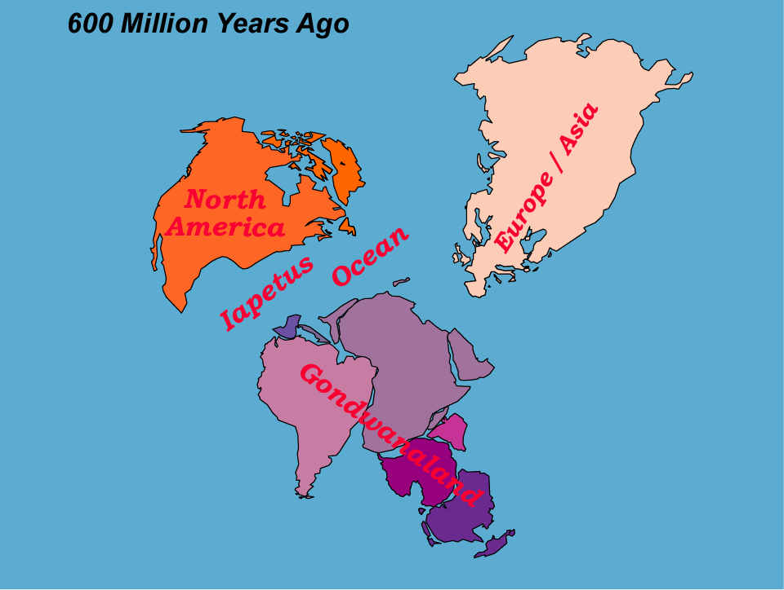
Iapetus Ocean Opens
TECTONIC DEVELOPMENT OF APPALACHIAN MOUNTAINS
Parks and Plates
©2005 Robert J. Lillie
Notes:
We enter the drama at the end of the Proterozoic about 600 million years ago. North America is separated from Eurasia and the then-joined southern continents (Gondwanaland) by the Iapetus Ocean.

Slide 26
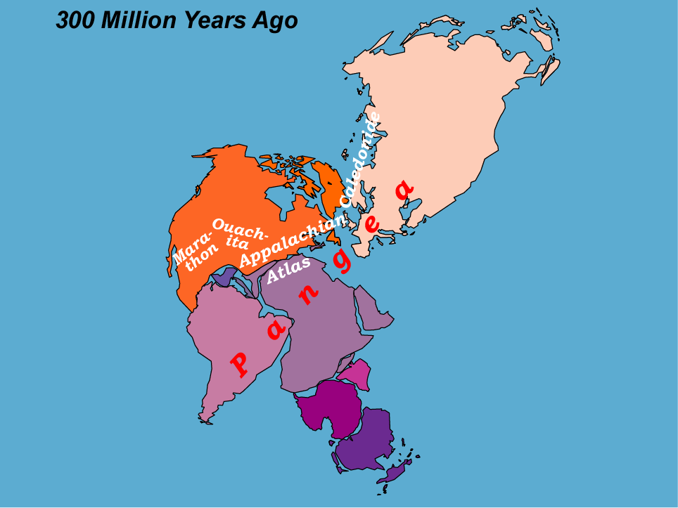
Iapetus Ocean Closes
TECTONIC DEVELOPMENT OF APPALACHIAN MOUNTAINS
Parks and Plates
©2005 Robert J. Lillie
Notes:
Towards the end of the Paleozoic, about 300 million years ago, the Iapetus becomes completely subducted as the continents collide to form Pangaea. The Marathon, Ouachitas, Appalachians, Atlas and Caledonian Mountains represent the sutures of Pangaea.

Slide 27
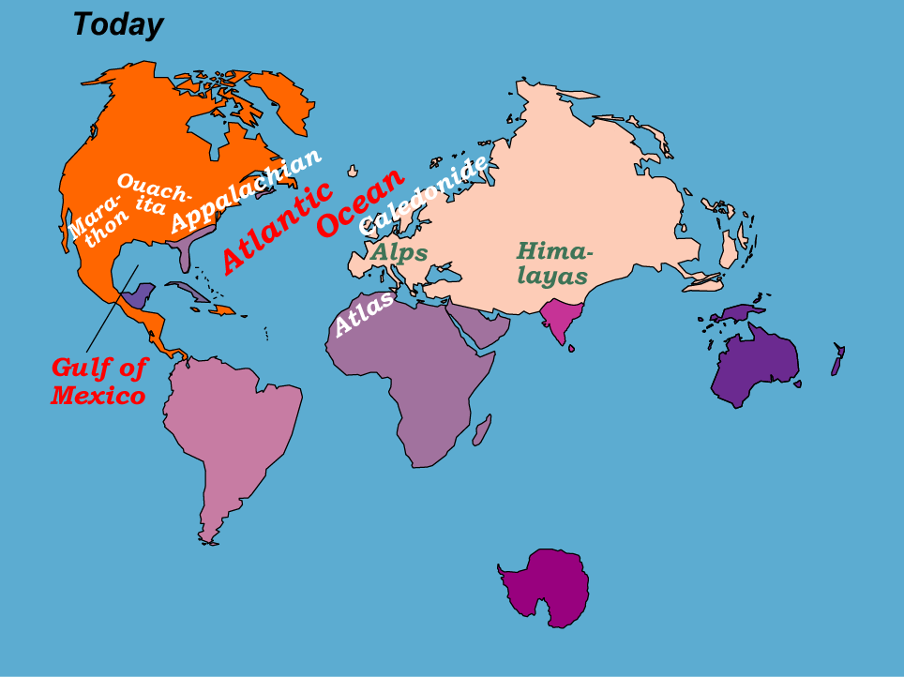
Atlantic Ocean and Gulf of Mexico Ocean
TECTONIC DEVELOPMENT OF APPALACHIAN MOUNTAINS
Parks and Plates
©2005 Robert J. Lillie
Notes:
The breakup of Pangaea has left the fragments of Gondwana in North America (Florida, Cuba and the Yucatan Peninsula in Mexico) and divided the sutures between North America, Africa and Northern Eurasia.

Slide 28
Tectonic Evolution of Southern Appalachian Mountains
North America
Gondwanaland
Pannotia Rifts Apart
Parks and Plates
©2005 Robert J. Lillie
Notes:
In cross-section, note that the first sediments to deposit on the supercontinent of Pannotia were deposited in rift valleys.

Slide 29
Tectonic Evolution of Southern Appalachian Mountains
Iapetus Ocean Opens
Parks and Plates
©2005 Robert J. Lillie
Notes:
Continued rifting opens the Iapetus Ocean while thick sequences of DCM sediments begin to accumulate over the rift valleys.

Slide 30
Tectonic Evolution of Southern Appalachian Mountains
Iapetus Ocean Closes During Subduction
Parks and Plates
©2005 Robert J. Lillie
Notes:
Subduction in the Iapetus begins in the early Paleozoic forming a volcanic arc and accretionary wedge in Gondwanaland while DCM sediments continue to thicken in North America.

Slide 31
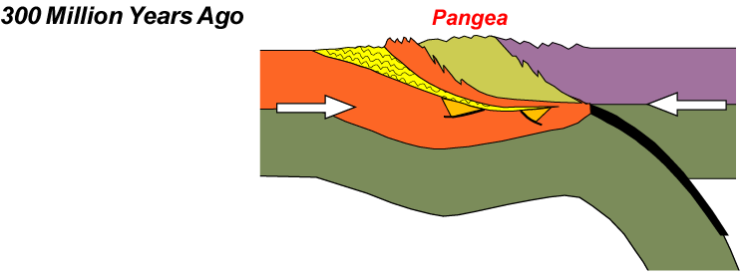
Tectonic Evolution of Southern Appalachian Mountains
Continents Collide, Forming Pangea
Parks and Plates
©2005 Robert J. Lillie
Notes:
The collision that occurs about 300 million years ago between the two massive continents (North America and Gondwanaland) in the Southern Appalachians is of the “hard” type. It thrusts a portion of the North American basement, as well as wedge and arc rocks from Gondwanaland, over folded North American DCM sediments.

Slide 32
Tectonic Evolution of Southern Appalachian Mountains
Atlantic Ocean Opens
Note Tectonic Provinces of Southern Appalachians
Parks and Plates
©2005 Robert J. Lillie
Notes:
As Pangaea rifts and the Atlantic Ocean opens, the components formed by the great collision become distinct tectonic provinces while modern DCM sedimentation covers the coastal plain.

Slide 33
ANCIENT COLLISIONAL MOUNTAIN RANGE
Parks and Plates
©2005 Robert J. Lillie
Notes:
This arrangement is most clearly seen in the Appalachian Mountains between Shenandoah and Great Smoky National Parks …

Slide 34
What do the Appalachians look like below the surface?
Line of Tectonic Cross Section
ANCIENT COLLISIONAL MOUNTAIN RANGE
Parks and Plates
©2005 Robert J. Lillie
Notes:
… where if we construct a cross section …

Slide 35
Southern Appalachian Mountains
Marshak, EARTH (Norton, 2005)
Parks and Plates
©2005 Robert J. Lillie
Notes:
… we can identify the collision-formed elements.

Slide 36
Southern Appalachian Mountains
Marshak, EARTH (Norton, 2005)
Parks and Plates
©2005 Robert J. Lillie
Notes:
The Valley and Ridge Province is largely made of folded and thrust-faulted Paleozoic sedimentary rocks deposited on the old DCM of North America.

Slide 37
The VALLEY AND RIDGE PROVINCE is a fold and thrust belt.
Parks and Plates
©2005 Robert J. Lillie
Notes:
The Valley and Ridge Province is a fold and thrust belt …

Slide 38
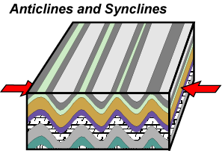
Compression folds the sedimentary layers, like pushing on a rug.
The VALLEY AND RIDGE PROVINCE is a fold and thrust belt.
Parks and Plates
©2005 Robert J. Lillie
Notes:
… formed by compression much like pushing on a rug. Importantly, there will be a significant amount of detachment that occurs between the relatively soft DCM sediments (the rug) and the relatively hard continental basement (the floor).

Slide 39
Compression also breaks and shoves the rock layers along thrust faults.
The VALLEY AND RIDGE PROVINCE is a fold and thrust belt.
Parks and Plates
©2005 Robert J. Lillie
Notes:
Compression also breaks and shoves the rock layers along thrust faults.

Slide 40
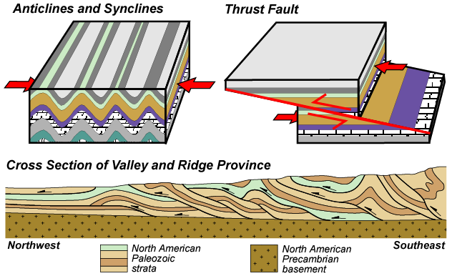
The VALLEY AND RIDGE PROVINCE is a fold and thrust belt.
The region has numerous folds and thrust faults.
Parks and Plates
©2005 Robert J. Lillie
Notes:
The valley and ridge province has numerous folds and thrust faults.

Slide 41
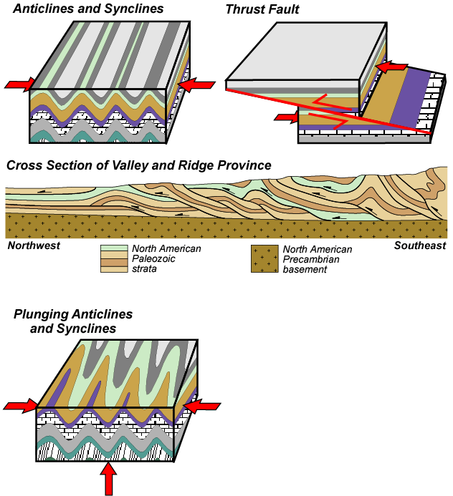
The VALLEY AND RIDGE PROVINCE is a fold and thrust belt.
Layers also tilt (“plunge”), eroding to V-shaped patterns.
Parks and Plates
©2005 Robert J. Lillie
Notes:
Since the amount of uplift due to folding and thrusting varies along the Appalachians, it is typical for one end of a fold to be higher than the other, producing what are known as “plunging” folds which erode into elongated “V” or “U” shapes.

Slide 42
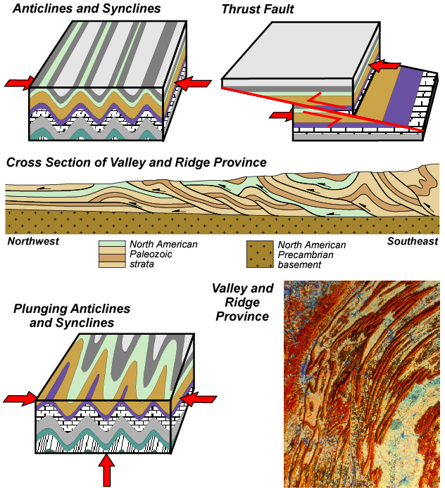
The VALLEY AND RIDGE PROVINCE is a fold and thrust belt.
Satellite photos reveal numerous plunging anticlines and synclines.
Parks and Plates
©2005 Robert J. Lillie
NASA
Notes:
Satellite photos of the Valley and Ridge Province …

Slide 43
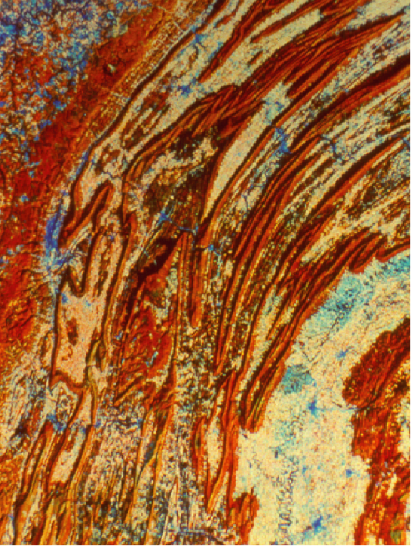
Valley and Ridge Province, Pennsylvania
Plunging Anticlines and Synclines
Parks and Plates
©2005 Robert J. Lillie
NASA
Notes:
… reveal numerous eroded plunging anticlines and synclines. The name “Valley and Ridge Province” is derived largely from the effects of differential erosion on the plunging folds. Ridges form where erosion-resistant rocks occur along the folds while valleys develop within the softer rocks.

Slide 44
The Valley and Ridge Province is a classic FOLD AND THRUST BELT
Marshak, EARTH (Norton, 2005)
Parks and Plates
©2005 Robert J. Lillie
Notes:
Remember that the Valley and Ridge Province is a fold and thrust belt.

Slide 45
The Valley and Ridge Province is a classic FOLD AND THRUST BELT
Folds
Thrust Faults
Marshak, EARTH (Norton, 2005)
Parks and Plates
©2005 Robert J. Lillie
Notes:
So along with the folds, thrust faults will complicate the structure.

Slide 46
Southern Appalachian Mountains
Marshak, EARTH (Norton, 2005)
Parks and Plates
©2005 Robert J. Lillie
Notes:
So the VALLEY AND RIDGE PROVINCE is comprised of sedimentary layers of the North American continent that were compressed, faulted and folded like a carpet.

Slide 47
Southern Appalachian Mountains
Marshak, EARTH (Norton, 2005)
Parks and Plates
©2005 Robert J. Lillie
Notes:
The Blue Ridge is the hard crust of North America that was deformed and uplifted as the continents collided.

Slide 48
Southern Appalachian Mountains
Marshak, EARTH (Norton, 2005)
Parks and Plates
©2005 Robert J. Lillie
Notes:
The PIEDMONT is made of sedimentary layers and hard oceanic crust that lay between North America and Africa, as well as oceanic islands and various accreted terranes. Relatively young granite also intrudes the older rocks.

Slide 49
Southern Appalachian Mountains
Marshak, EARTH (Norton, 2005)
Parks and Plates
©2005 Robert J. Lillie
Notes:
The COASTAL PLAIN is covered with sedimentary layers deposited along the divergent (passive) continental margin that subsided as the Atlantic Ocean opened.

Slide 50
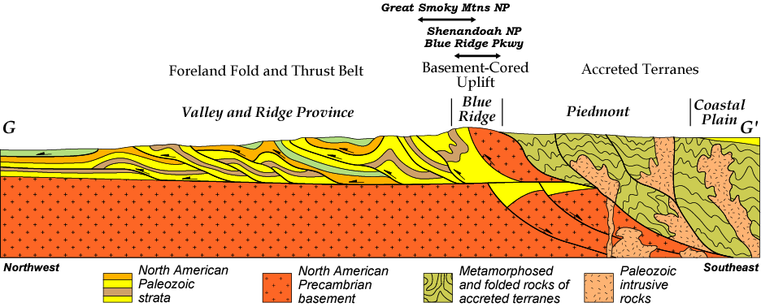
Southern Appalachian Mountains
Marshak, EARTH (Norton, 2005)
Parks and Plates
©2005 Robert J. Lillie
Notes:
Shenandoah lies on the Blue Ridge while Great Smoky Mountains National Park extends from the Blue Ridge into the Valley and Ridge Province.

Slide 51
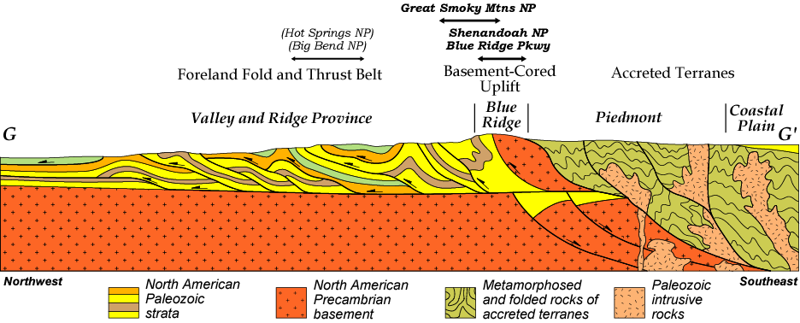
Southern Appalachian Mountains
Marshak, EARTH (Norton, 2005)
Parks and Plates
©2005 Robert J. Lillie
Notes:
Parks in the Ouachita and Marathon Mountains lie along the western extension of the deformed sedimentary strata that comprise the Valley and Ridge Province.

Slide 52
The Appalachian/Ouachita/Marathon collisional mountain range lies along the ANCIENT CONTINENTAL MARGIN of North America
Parks and Plates
©2005 Robert J. Lillie

Slide 53
WEBSITES
National Park Service: www.nps.gov Park Geology Tour: www2.nature.nps.gov/grd/tour/index.htm Appalachian/Ouachita/Marathon - 15. Acadia NP: www2.nature.nps.gov/grd/parks/acad/index.htm 16. Big South Fork NR: www2.nature.nps.gov/grd/parks/biso/index.htm 17. Blue Ridge Parkway: www2.nature.nps.gov/grd/parks/blri/index.htm 18. Bluestone NSR&RA: www2.nature.nps.gov/grd/parks/neri/index.htm 19. Chattahoochee River NRA: www.nps.gov/chat/index.htm 20. Delaware Water Gap NRA: www2.nature.nps.gov/grd/parks/dewa/index.htm 21. Gauley River NRA: www2.nature.nps.gov/grd/parks/neri/index.htm 22. Great Smoky Mountains NP: www2.nature.nps.gov/grd/parks/grsm/index.htm 23. Obed WSR: www.nps.gov/obed/index.htm 24. Russell Cave NM: www2.nature.nps.gov/grd/parks/ruca/index.htm 25. Shenandoah NP: www2.nature.nps.gov/grd/parks/shen/index.htm 26. Hot Springs NP: www2.nature.nps.gov/grd/parks/hosp/index.htm 27. Big Bend NP: www2.nature.nps.gov/grd/parks/bibe/index.htm 28. Rio Grande WSR: www.nps.gov/rigr/index.htm ^{Brooks Range -} 29. Cape Krusenstern NP: www2.nature.nps.gov/grd/parks/noaa/index.htm 30. Gates of the Arctic NP: www2.nature.nps.gov/grd/parks/gaar/index.htm 31. Kobuk Valley NP: www2.nature.nps.gov/grd/parks/noaa/index.htm 32. Noatak NP: www2.nature.nps.gov/grd/parks/noaa/index.htm U. S. Geological Survey: www.usgs.gov/ Geology in the Parks: www2.nature.nps.gov/grd/usgsnps/project/home.html
Parks and Plates
©2005 Robert J. Lillie

